Slide 1


CAPSTONE DESIGN 02 PRESENTATION
NETWOD
Team 14
Kim Jeong hoon 20146235
Min Sung jae 20145223 (Presenter)
Go Sung ju 20165245

Slide 2
01 Weekly plan
02 Progress
INDEX
03 Problems & Solutions
04 Next week plan
05 Github Activity

Slide 3
1 ”
Weekly plan

Slide 4

01
Weekly plan
Plan
02
03
 | 2nd | 3rd | 4th | 5th | 6th | M I D D E M O
Jeonghoon,Kim | Defining data structure for database | Basic android UI design& develop |  | Basic android app function design&develop | Integrating modules & Test
Sungjae,Min | Making excel sheet template& Data collection | Implementation of excel parsing module | Implementation of App database
Sungju,Go |  | WOD data collection& data store to data structure | Implementation of WOD generating module
 | 9th | 10th | 11th | 12th | 13th | F I N D E M O
Jeonghoon,Kim | Community android UI design& develop |  | Community android app function design & develop |  | Integrating modules& test
Sungjae,Min | Build community server system |  | DB system implementation & Build data transfer module
Sungju,Go | Implementation of statistical function
04

Slide 5
2”
Progress

Slide 6
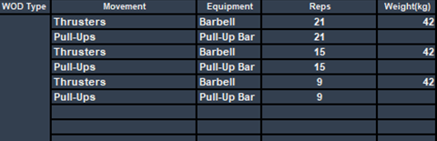
02
Progress [Go sungju]
Progress
01
Implementation of WOD generating module
03
04
Movement
Name
Num
Weight
score
WOD
Name
Level
Movement list
type

Slide 7
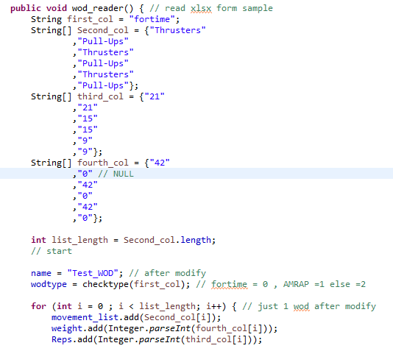
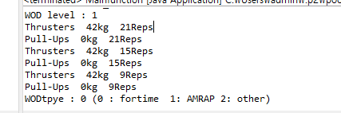
02
Progress
Progress
01
Implementation of WOD generating module
03
04

Slide 8
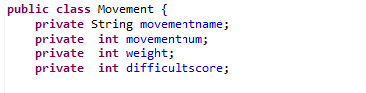
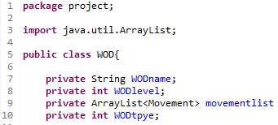
02
Progress
Progress
01
Implementation of WOD generating module
03
04
Movement
Generate Function
Movement
Name
Num
Weight
score
WOD
Name
Level
Movement list
type
Read
Excel file
Learning and
making Part
(Next Week)
Recommend
famous WOD

Slide 9
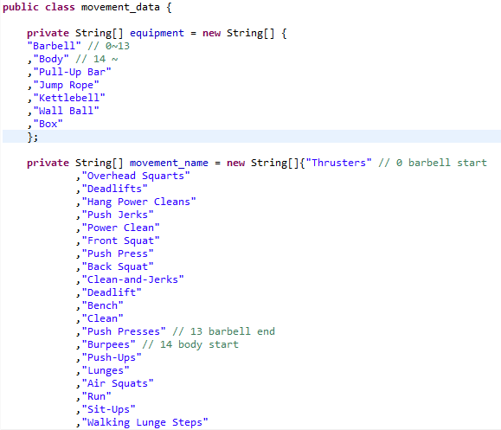
02
Progress
Progress
01
Implementation of WOD generating module
03
04
Movement
Name
Num
Weight
score
WOD
Name
Level
Movement list
type

Slide 10
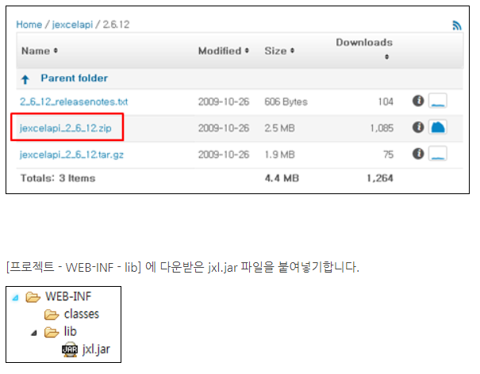
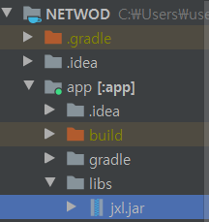
02
Progress [Min sungjae]
Progress
01
03
04
Add jexcel api Library
To Androi Studio for Excel file handling

Slide 11
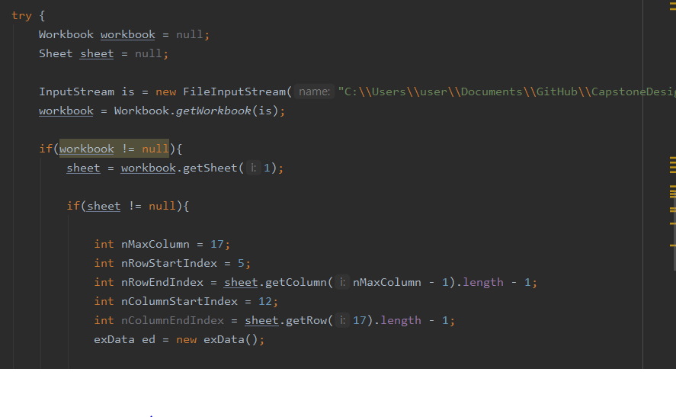
02
Progress
Progress
01
03
04
Test Read Excel file
In Android Studio

Slide 12

02
Progress
Progress
01
03
04
Implementation internal
Database SQLite
To save Excel Data

Slide 13
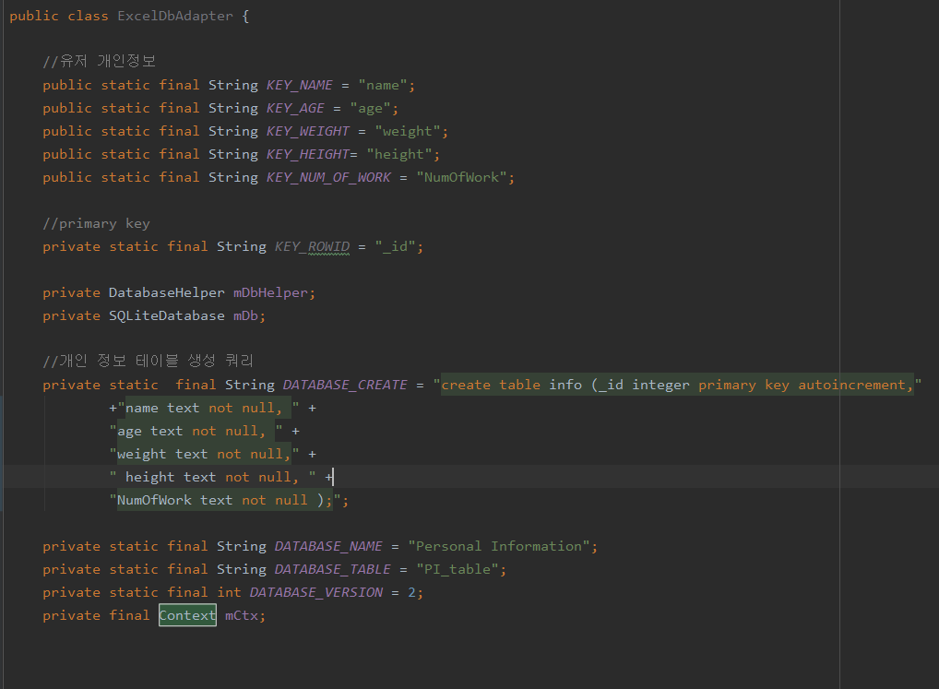
02
Progress
Progress
01
03
04
Utilize internal classes to implement
a database fram

Slide 14
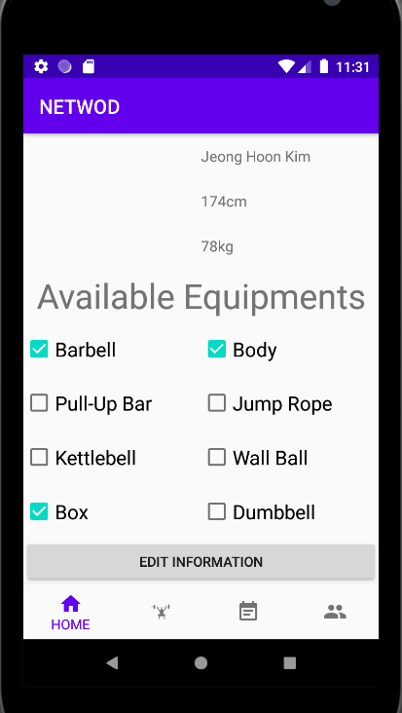
02
Progress [Kim jeong hoon]
Progress
01
03
04
[Home fragment]
Add Edit Information fragment

Slide 15
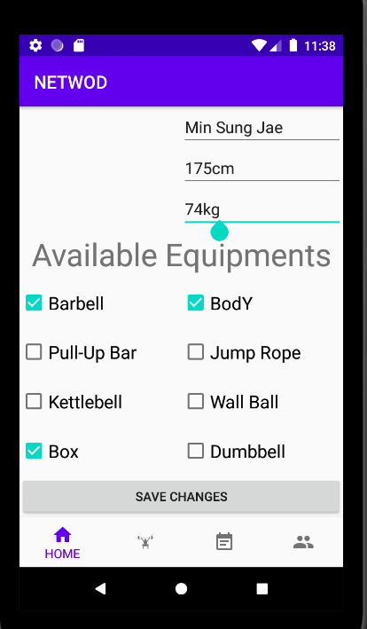
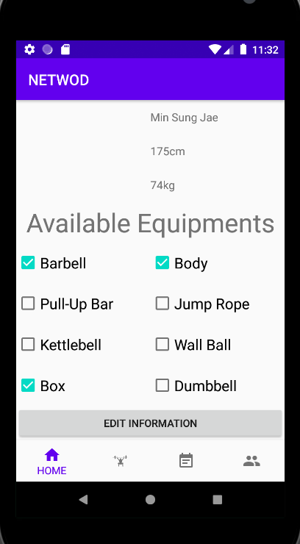
02
Progress
Progress
01
03
04
[Home fragment]
Information Modify UI
[Home fragment]
After Modify UI

Slide 16
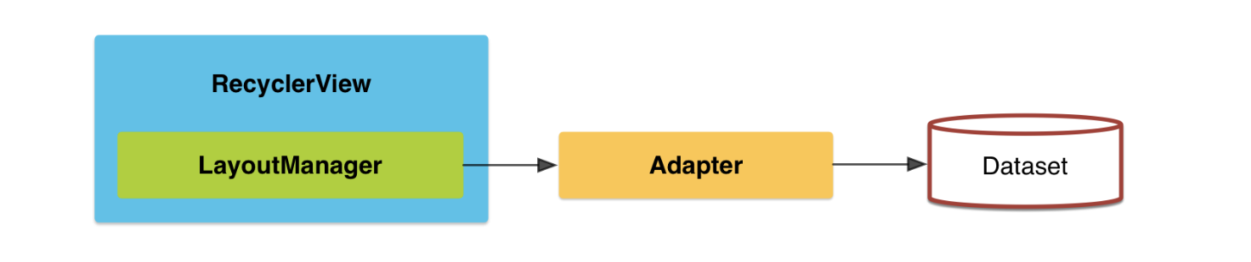
02
Progress
Progress
01
03
[WOD List fragment]
Listview -> Recyclerview
04

Slide 17
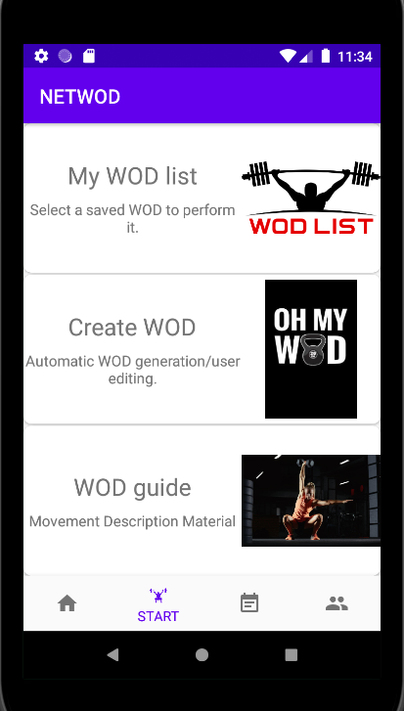
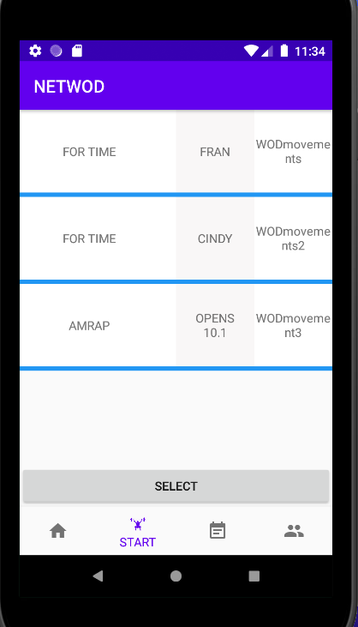
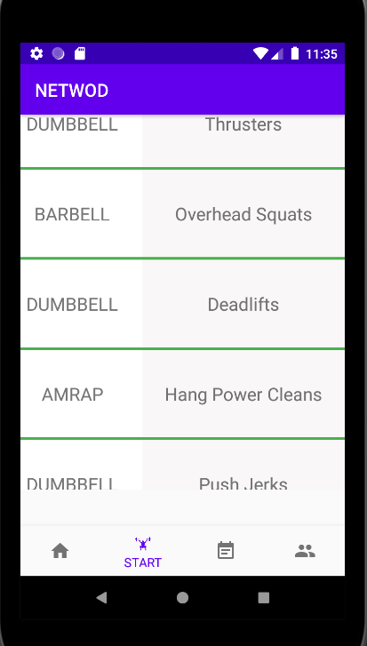
02
Progress
Progress
01
03
04
[Start fragment]
WOD List , WOD Guide UI
(Use recyclerview) ‘Scroll Mode’

Slide 18
3”
Problems & Solutions

Slide 19

03
Problems [1]
Progress
01
02
04
Using Apache POI Library
-> Read Excel file problem
-> Version of Excel ( .xlsx or .xls ??)

Slide 20

03
Solution
Progress
01
02
04
Using Jexcel Library
-> Easy to read Excel file
-> Use .xls version of Excel

Slide 21
03
Problems [2]
Progress
01
02
04
Using Recyclerview vs Listview
-> Hard to customizing
-> Structural problem

Slide 22
03
Solution
Progress
01
02
04
Using RecyclerView
-> Scroll Mode
-> Flexibility to handle a lot of data

Slide 23
4”
Next week plan

Slide 24
04
Next
Next
01
02
 | 2nd | 3rd | 4th | 5th | 6th | M I D D E M O
Jeonghoon,Kim | Defining data structure for database | Basic android UI design& develop |  | Basic android app function design&develop | Integrating modules & Test
Sungjae,Min | Making excel sheet template& Data collection | Implementation of excel parsing module | Implementation of App database
Sungju,Go |  | WOD data collection& data store to data structure | Implementation of WOD generating module
 | 9th | 10th | 11th | 12th | 13th | F I N D E M O
Jeonghoon,Kim | Community android UI design& develop |  | Community android app function design & develop |  | Integrating modules& test
Sungjae,Min | Build community server system |  | DB system implementation & Build data transfer module
Sungju,Go | Implementation of statistical function
03

Slide 25
5”
Github Activity

Slide 26
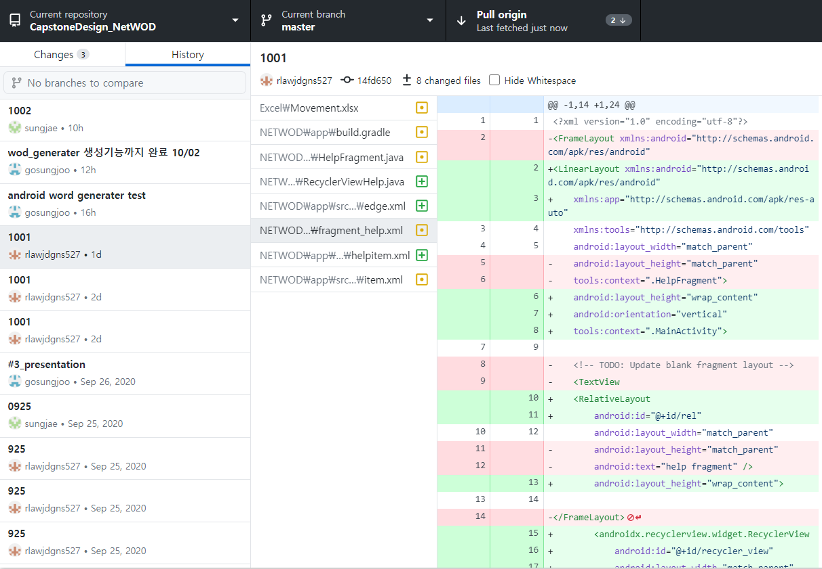
05
Github Activity
Github
01
02
03

Slide 27

Thank You!

